Slide 1


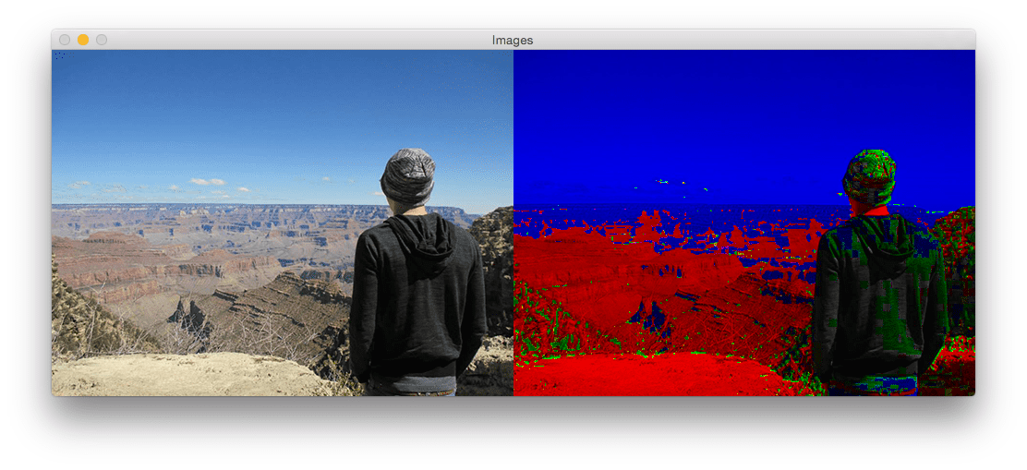
Session 6: Applying Filters

Slide 2
1. Blurring (Gaussian Blur)
What It Does: Smooths an image, like looking through frosted glass. Why Use It: Hide details (e.g., blur faces for privacy), reduce noise
import cv2
import numpy as np
# Load image
image = cv2.imread("flower.jpg")
# Apply Gaussian blur (kernel size must be odd: 3, 5, 7...)
blurred = cv2.GaussianBlur(image, (15, 15), 0) # (width, height), sigma
cv2.imshow("Blurred flower", blurred)
cv2.waitKey(0)
What’s Happening:
The (15,15) kernel averages pixels in a 15x15 grid around each pixel.
Larger kernel = more blur!

Slide 3
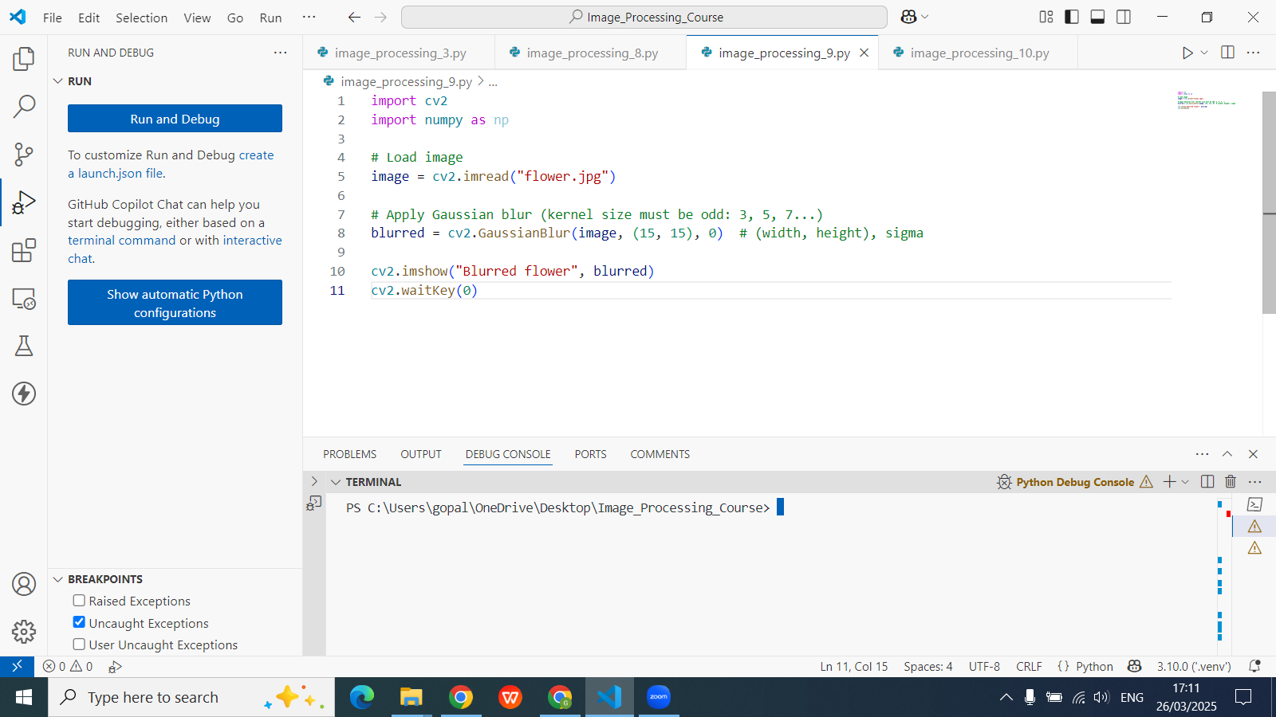

Slide 4
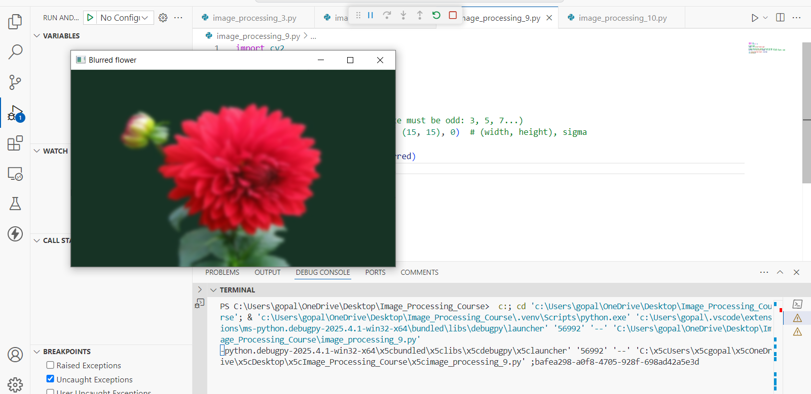

Slide 5
2. Edge Detection (Canny Edge Detector)
What It Does: Finds sharp edges, like drawing outlines with a pencil. Why Use It: Detect shapes, objects, or text in images.
import cv2
import numpy as np
# Load image
image = cv2.imread("flower.jpg")
# Convert to grayscale
gray = cv2.cvtColor(image, cv2.COLOR_BGR2GRAY)
# Detect edges (adjust thresholds)
edges = cv2.Canny(gray, 100, 200) # minVal=100, maxVal=200
cv2.imshow("Edges", edges)
cv2.waitKey(0)

Slide 6
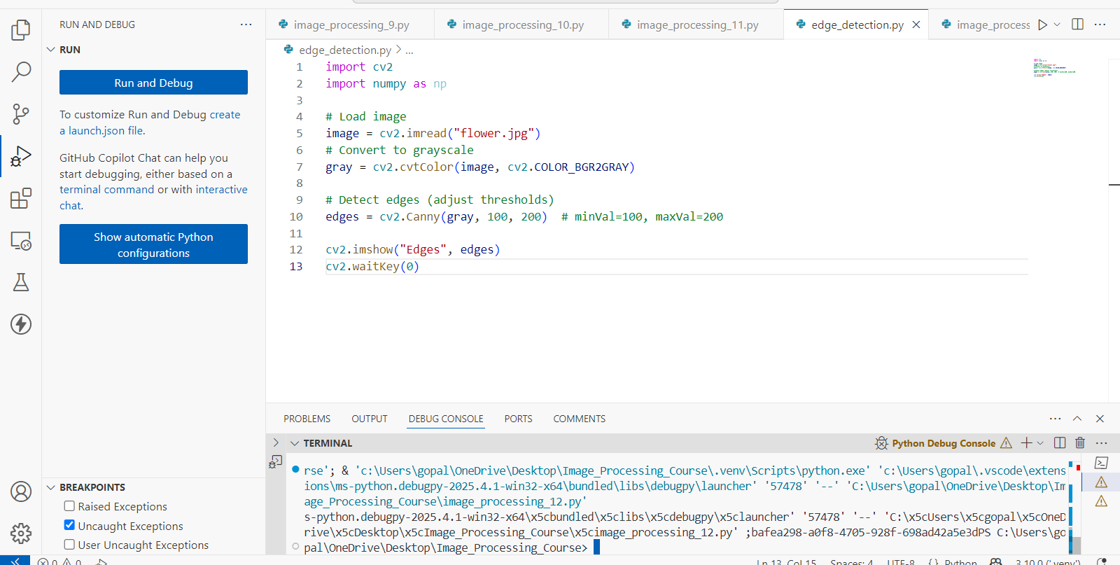

Slide 7
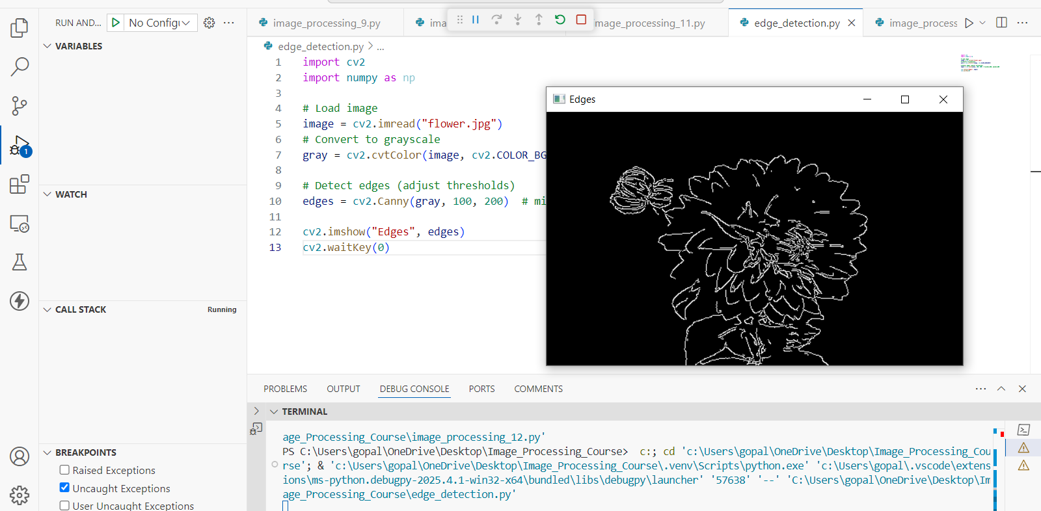

Slide 8
What’s Happening:
Pixels with gradients above maxVal = edges.
Pixels below minVal = ignored.
Experiment with thresholds for finer/coarser edges!

Slide 9
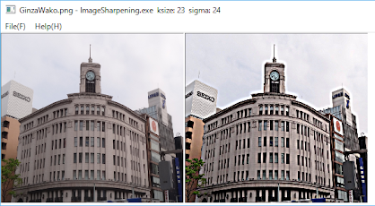
3. Sharpening
What It Does: Makes edges pop, like adding a "clarity" filter. Why Use It: Fix blurry photos or enhance textures.
Method 1

Slide 10
import cv2
import numpy as np
# Load image
image = cv2.imread("flower.jpg")
# Define a sharpening kernel
kernel = np.array([[0, -1, 0],
[-1, 5, -1],
[0, -1, 0]])
# Apply the sharpening filter
sharpened = cv2.filter2D(image, -1, kernel)
# Display the images
cv2.imshow("Original", image)
cv2.imshow("Sharpened (Kernel)", sharpened)
cv2.waitKey(0)
cv2.destroyAllWindows()

Slide 11
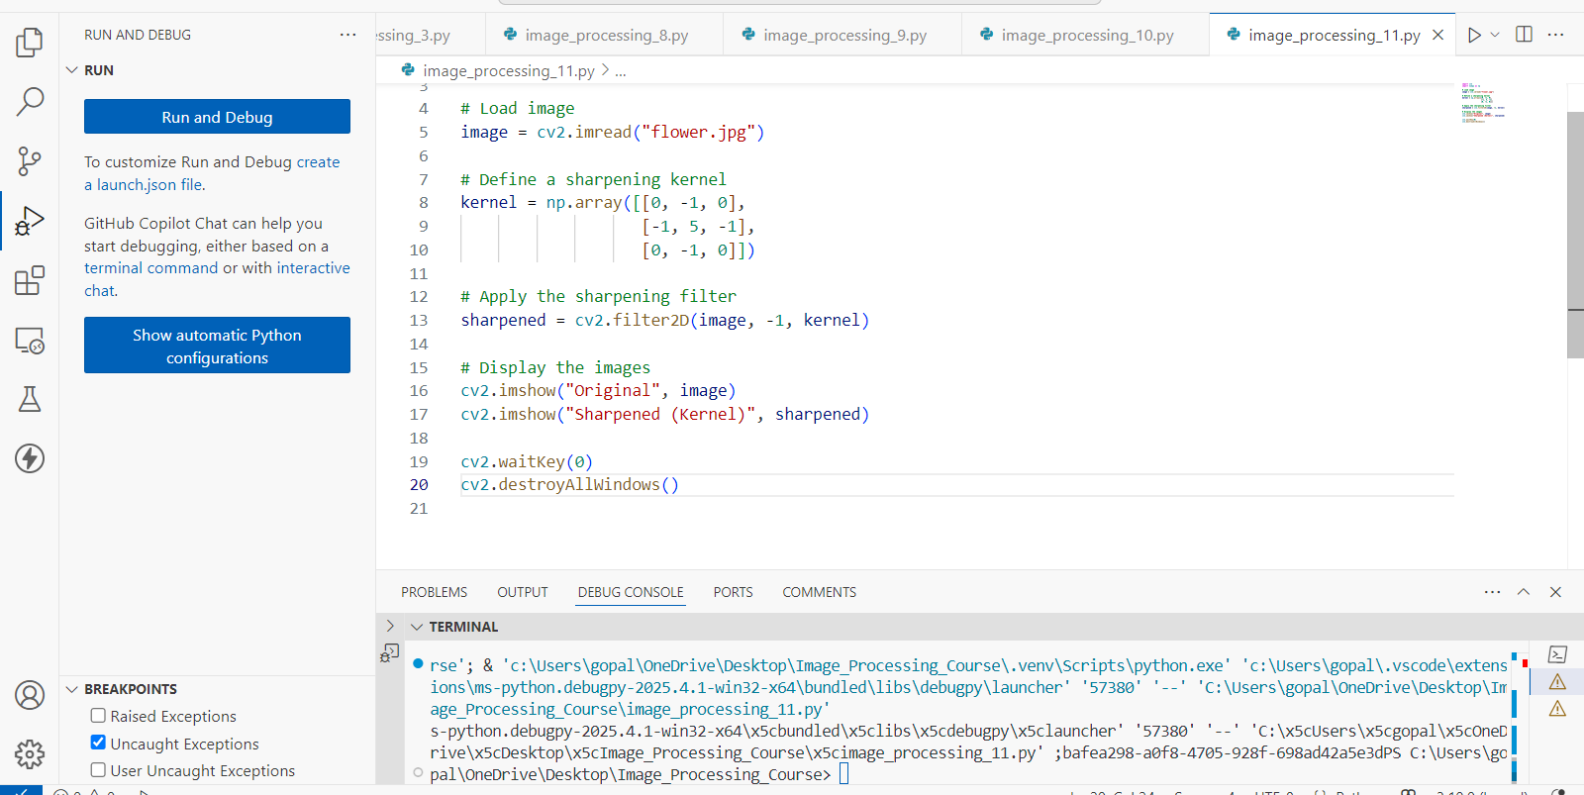

Slide 12
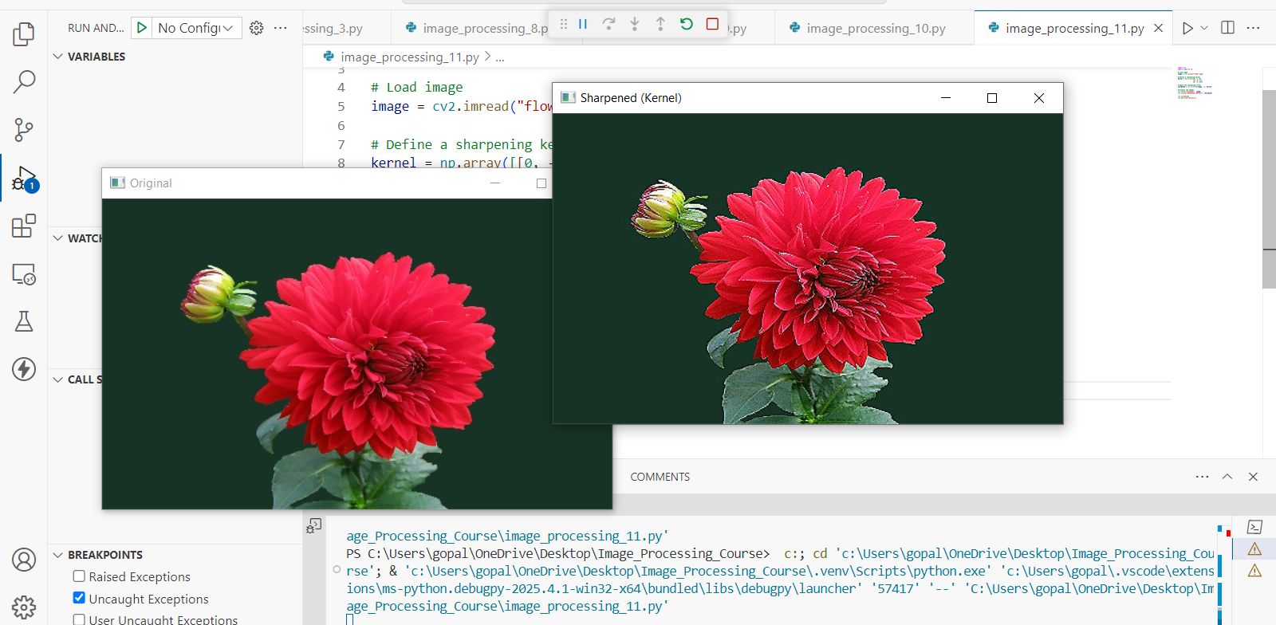

Slide 13
Method 2
import cv2
# Load image
image = cv2.imread("flower.jpg")
# Apply Gaussian Blur
blurred = cv2.GaussianBlur(image, (0, 0), 5)
# Unsharp masking: Original + Weighted difference
sharpened = cv2.addWeighted(image, 1.5, blurred, -0.5, 0)
# Display the images
cv2.imshow("Original", image)
cv2.imshow("Sharpened (Unsharp Masking)", sharpened)
cv2.waitKey(0)
cv2.destroyAllWindows()

Slide 14


Slide 15
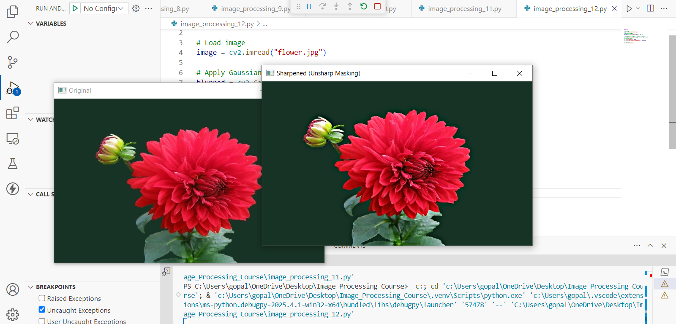

Slide 16
What’s Happening:
Method 1: The kernel emphasizes edges by boosting center pixels.
Method 2: Subtract a blurred version from the original to enhance edges.
Real-World Examples
Blurring: Hide license plates in photos.
Edge Detection: Self-driving cars detecting lane markings.
Sharpening: Making old family photos look crisp.

Slide 17
What’s Happening:
Method 1: The kernel emphasizes edges by boosting center pixels.
Method 2: Subtract a blurred version from the original to enhance edges.
Real-World Examples
Blurring: Hide license plates in photos.
Edge Detection: Self-driving cars detecting lane markings.
Sharpening: Making old family photos look crisp.
Fun Experiments
Blur Competition: Who can blur an image the most without making it unrecognizable?
Edge Art: Convert a photo into a black-and-white sketch using edges.
Sharpen a Meme: Add text to a sharpened meme template.

Slide 18
Exercise
1. What is the main purpose of applying Gaussian Blur to an image? A. Enhance image colors B. Increase image size C. Smooth the image and reduce details D. Convert to grayscale
Correct Answer: C. Smooth the image and reduce details
2. What must be true about the kernel size used in cv2.GaussianBlur()? A. It must be a power of two B. It must be even C. It must be divisible by 10 D. It must be odd
Correct Answer: D. It must be odd

Slide 19
Exercise
3. In Canny edge detection, what happens to pixels w C. They are ignored D. They are converted to blacith gradient values above the maxVal threshold? A. They are blurred B. They are marked as edgesk
Correct Answer: B. They are marked as edges
4. Which kernel is commonly used in Method 1 for sharpening images? A. Identity kernel B. Blur kernel C. [[0, -1, 0], [-1, 5, -1], [0, -1, 0]] D. [[1, 1, 1], [1, 1, 1], [1, 1, 1]]
Correct Answer: C. [[0, -1, 0], [-1, 5, -1], [0, -1, 0]]

Slide 20
Exercise
5. What is the concept behind the "unsharp masking" method in sharpening? A. Averaging pixels with neighbors B. Adding noise to the image C. Subtracting a blurred version from the original D. Converting to binary before filtering
Correct Answer: C. Subtracting a blurred version from the original

